Slide 1



Smart Traffic Management
System
Leveraging IoT and AI for Optimized Traffic Flow
next slide

Slide 2


02
Objective
Introduce the system aimed at optimizing traffic flow and reducing congestion using IoT technologies.
next slide

Slide 3
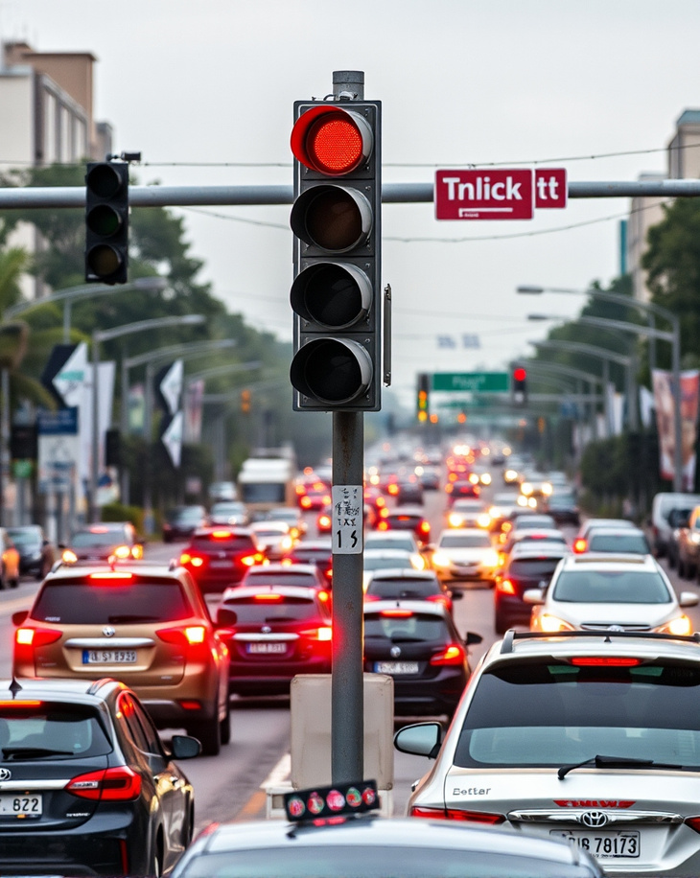
03
Problem
Congestion: Urban areas suffer from high traffic congestion, leading to delays and increased pollution.
Inefficient Traffic Lights: Traditional traffic lights operate on fixed timers, not adapting to real-time conditions.
Emergency Vehicle Delays: Emergency vehicles are significantly delayed in heavy traffic, posing safety risks.
Accident-Prone Areas: Identifying and managing accident-prone zones is crucial for safety.
next slide

Slide 4

Solution
04
Implement Raspberry Pi equipped with cameras and YOLO technology to assess and analyze vehicle density on the road.
Adjust traffic signals in real-time based on current traffic conditions through MQTT communication.
Enable immediate override of standard traffic signals to facilitate the swift passage of emergency vehicles.
Utilize BLE technology to detect vehicle proximity in high-risk areas, allowing for timely adjustments of traffic signals.
next slide

Slide 5



05
System Consists of
ADAPTIVE TRAFFIC LIGHT SYSTEM
EMERGENCY VEHICLE RESPONDING SYSTEM AI
ACCIDENT DETECTION SYSTEM
next slide

Slide 6
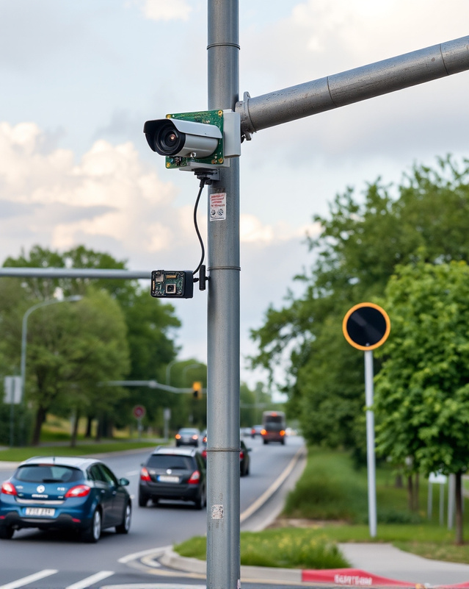
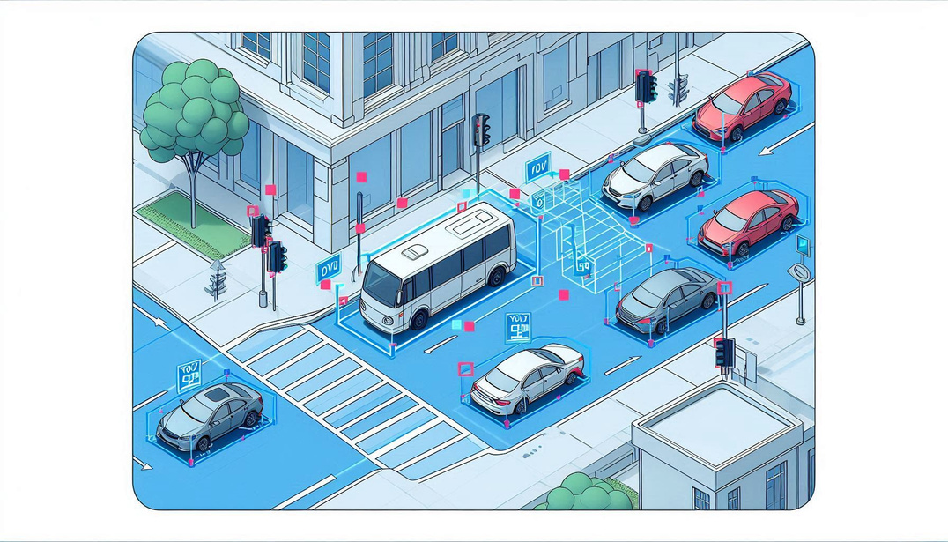


06
Adaptive Traffic light
system
Monitoring Begins: Raspberry Pi Cameras Installed on Two Roads
YOLO Model in Action: Determining Vehicle Counts in Real Time
Data Transmission: Vehicle Counts Sent via MQTT to Node-RED for Traffic Control

Slide 7

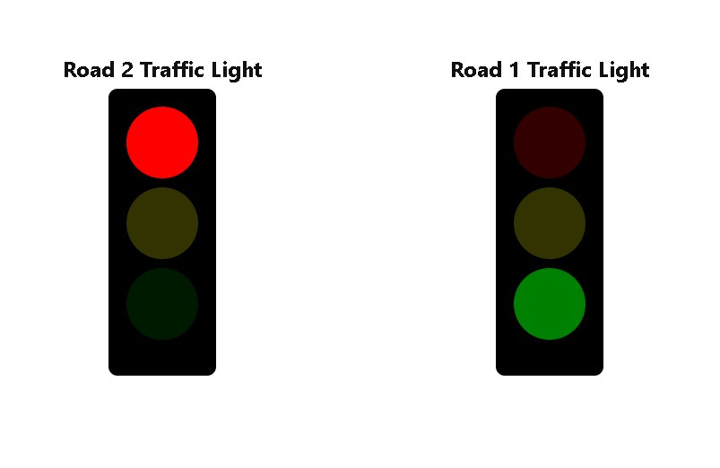
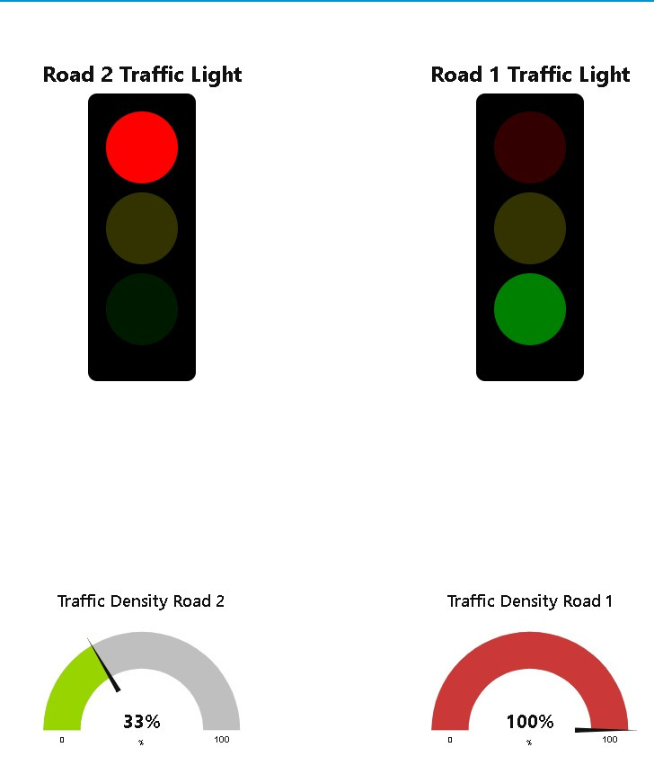
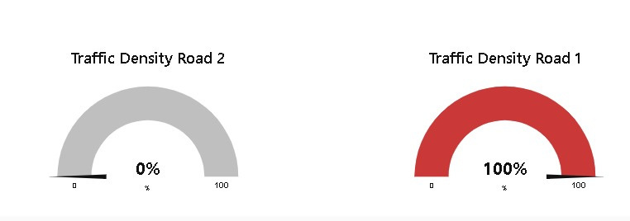
07
Adaptive Traffic light
system
State 1

Slide 8
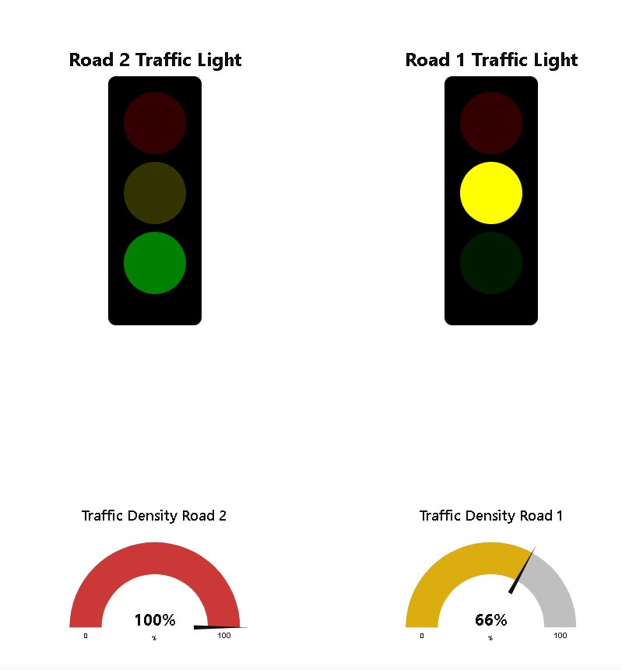
08
Adaptive Traffic light
system
State 2

Slide 9
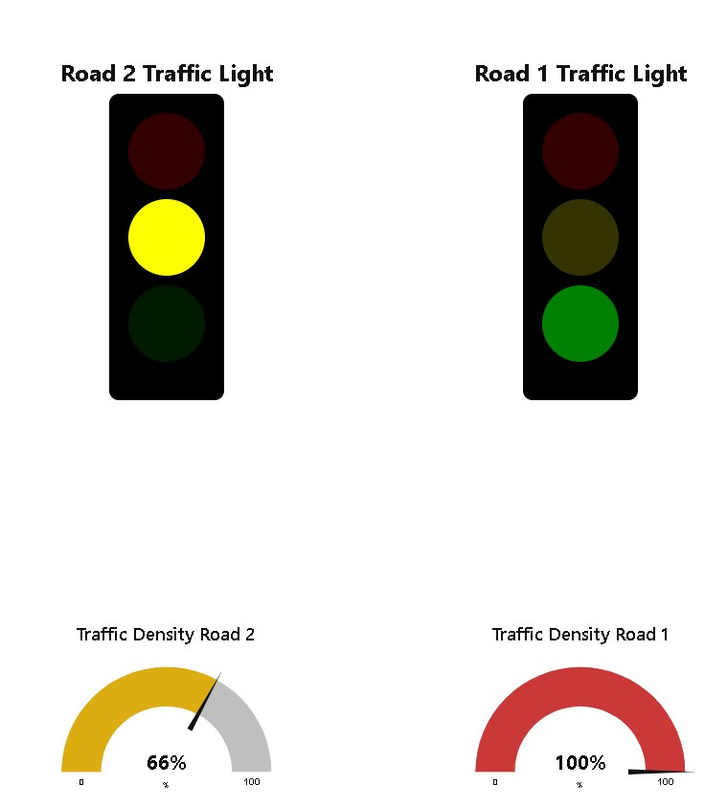
09
Adaptive Traffic light
system
State 3

Slide 10



10
Emergency Vehicle Responding System
Emergency Vehicle send message
Signal Sent
Normal Traffic Resumes: Road Lights Return to Adaptive State After Ambulance Passage

Slide 11
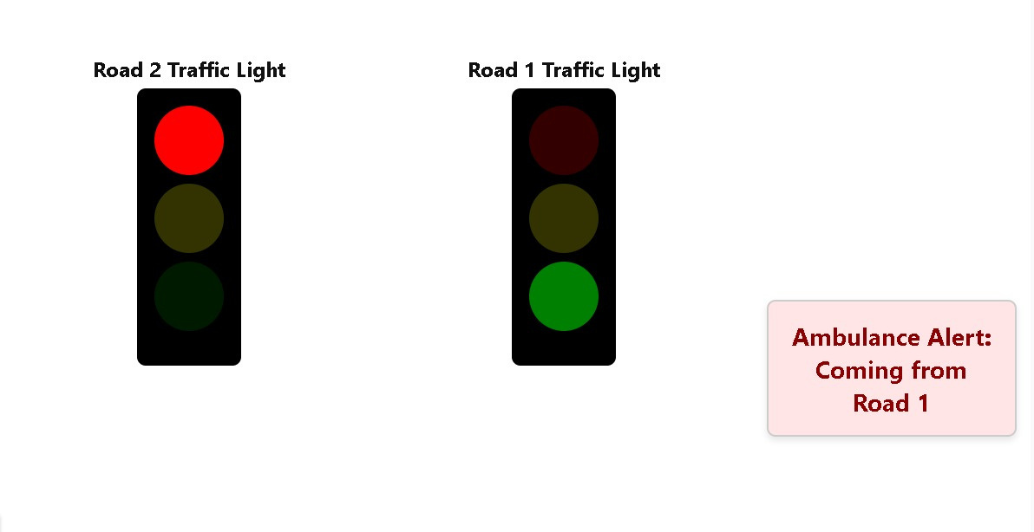
11
Emergency Vehicle Responding System
State 1

Slide 12
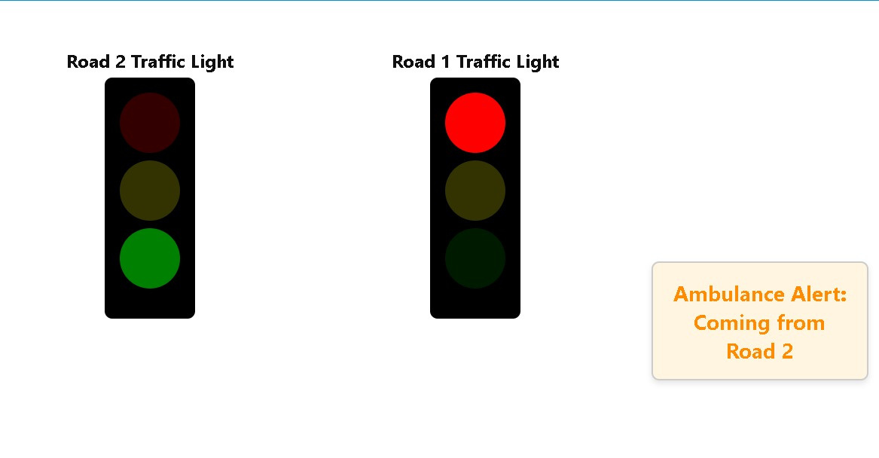
12
Emergency Vehicle Responding System
State 2

Slide 13
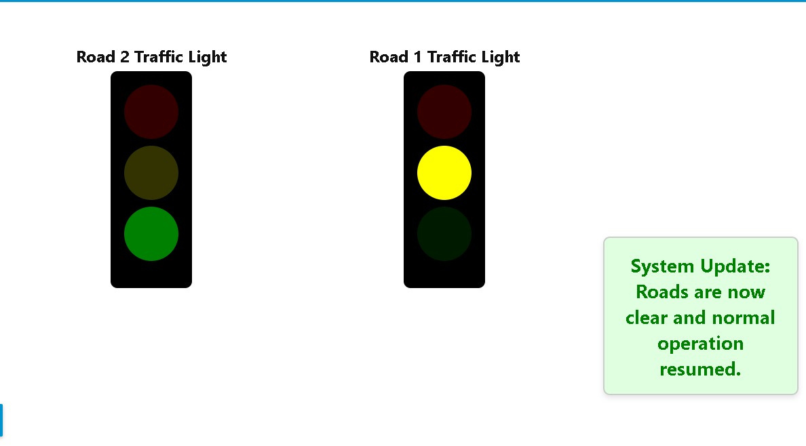
13
Emergency Vehicle Responding System
State 3

Slide 14
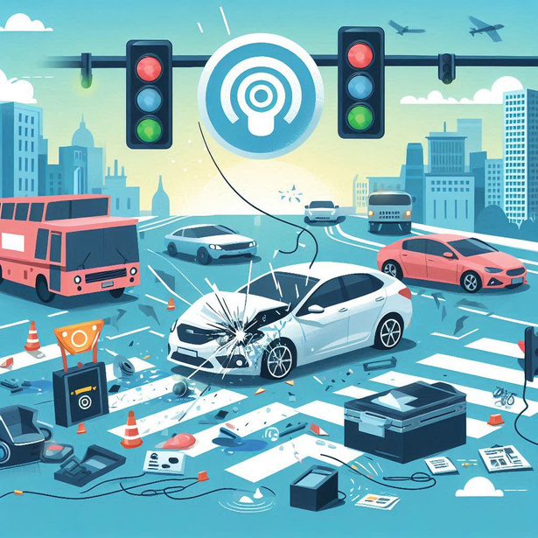

14
Accident Detection System
Accident Detected by IMU sensor signal
Location Determined: Bluetooth Signals Guide Raspberry Pi in Identifying Accident Road

Slide 15
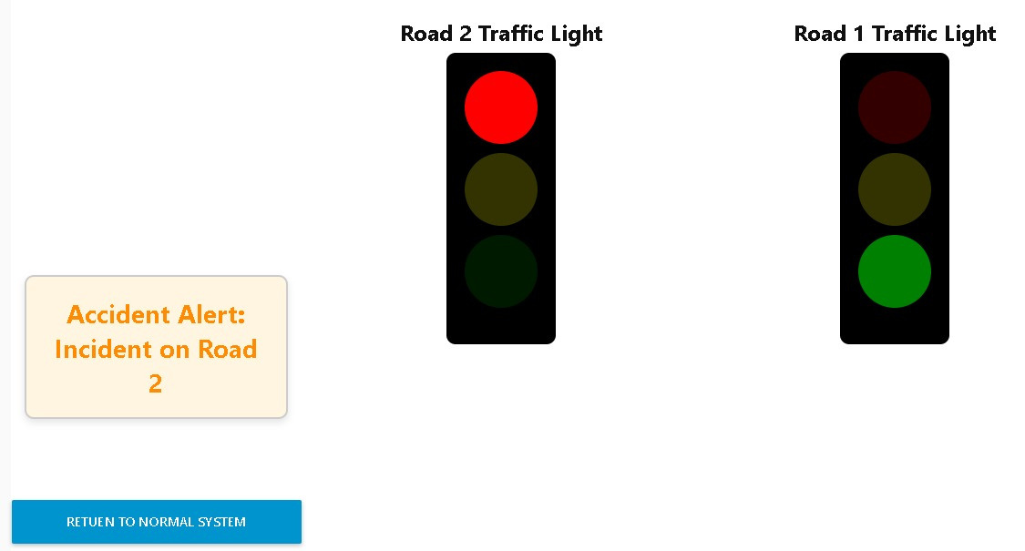
15
Accident Detection System
State 1

Slide 16
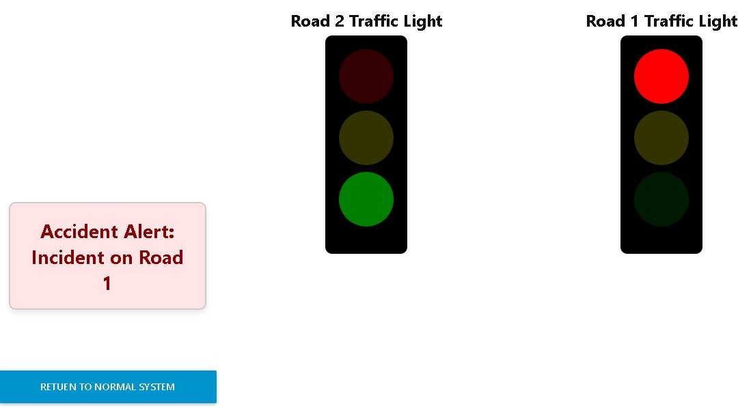
16
Accident Detection System
State 2

Slide 17
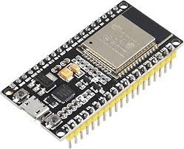
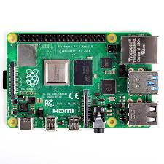
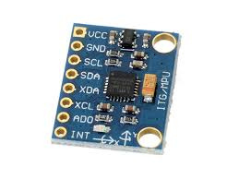
Materials
17
ESP32
RASBBERY PI 4&3
MPU 6050 SENSOR
next slide

Slide 18
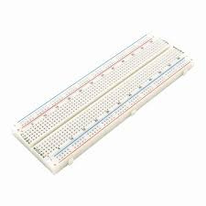
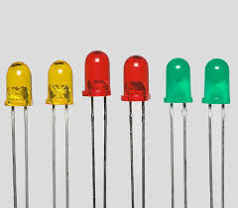
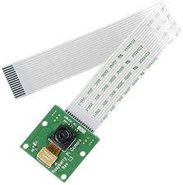
Materials
18
BREADBOARD
6 LEDS
2 RSPBERRY CAMERAS
next slide

Slide 19
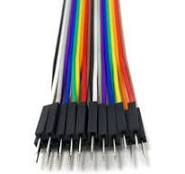

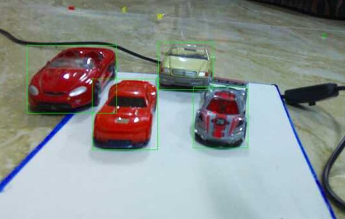
Materials
19
JUPMBERS
THICK PAPER
MACET CARS
next slide

Slide 20



Tools
20
HIVEHQ
NODE RED
YOLO MODEL
next slide

Slide 21


21
System Architecture
NodeRed

Slide 22
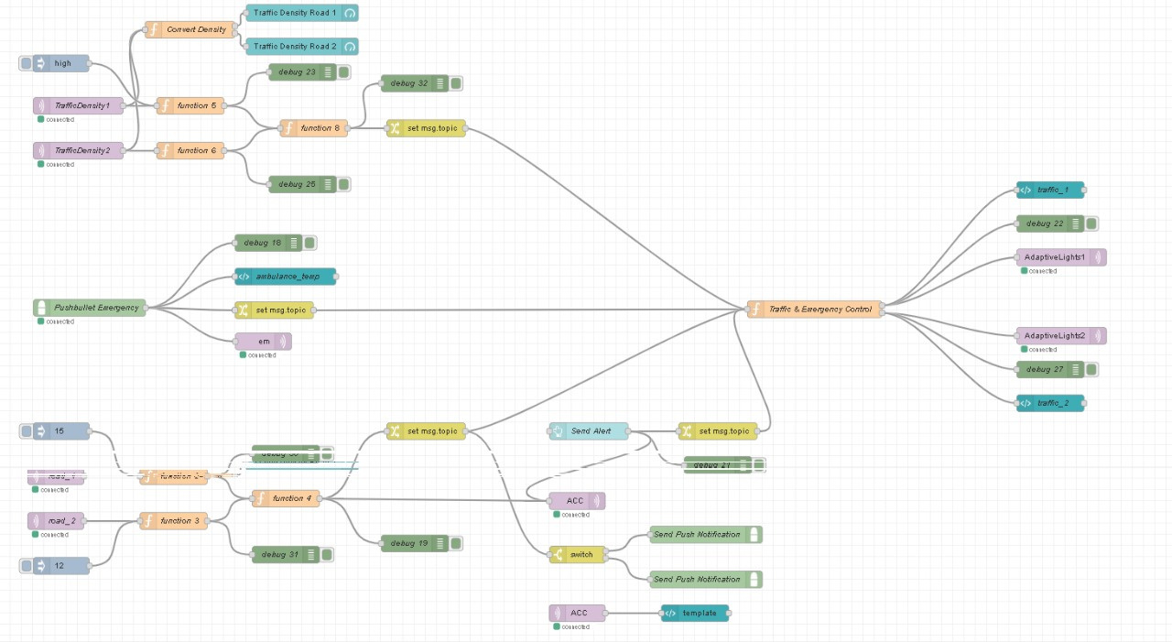
22
System Architecture

Slide 23
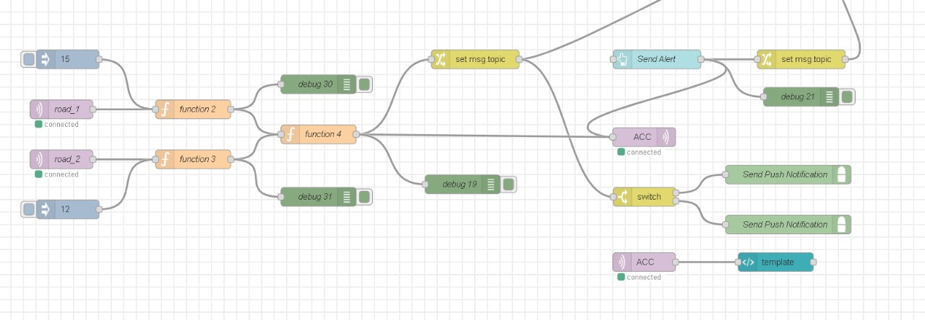
23
System Architecture

Slide 24

24
09
OUR TEAM
SEIF ELDIN
AHMED
SABRY
MOHAMED OSAMA
BAKR
KARIM ALAA
AHMED HANY
AHMED AMIN

Slide 25
25
Thank You!

